Slide 1


Music Recommendation System
Name: Kalyani Bang (248520)
Sharayu Dange (248546)
Group No : 6
Guided by: Dr . Shantanu Pathak

Slide 2
Problem Statement
In the digital era, music streaming platforms have vast libraries containing millions of songs. However, users often struggle to discover new music that aligns with their preferences. So the goal of this project is to develop a music recommendation system that predicts songs similar to the given input songs based on the song features.

Slide 3
Objectives
To develop a content-based filtering system for music recommendation.
To analyse audio features and determine their correlation with popularity.
To visualize the data using graphs and charts for better understanding.
To generate personalized music recommendations.

Slide 4
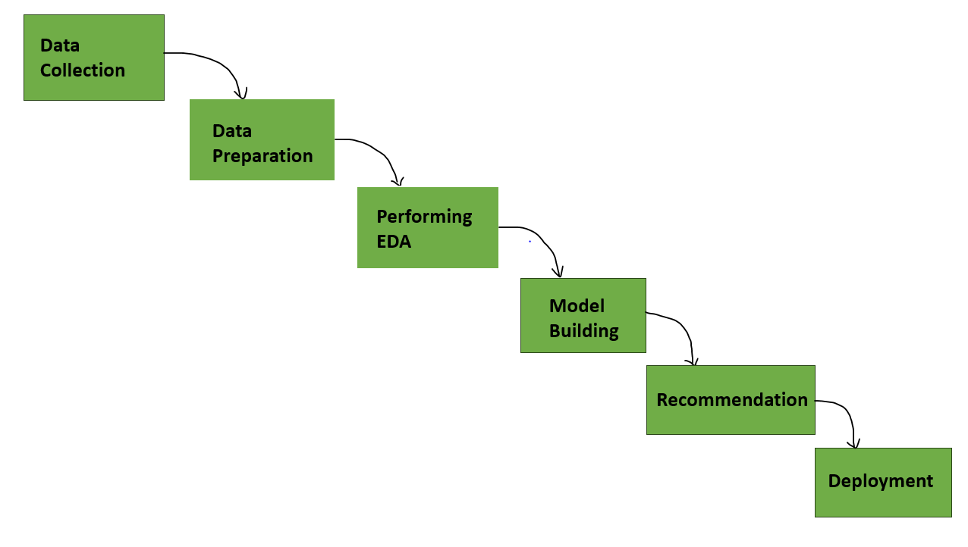
Workflow

Slide 5
Dataset Description
We are using dataset from Kaggle https://www.kaggle.com/code/mayankzach/spotify-music-recommendation/notebook
data.csv - 170653, 19 Features

Slide 6
Technologies & Libraries Used
Python Libraries:
Data Manipulation: numpy, pandas
Visualization: seaborn, matplotlib, plotly.express
Machine Learning: K-Means, Elbow Method, Cosine Similarity
Statistical Analysis: scipy (Pearson, Spearman, Kendall correlations)

Slide 7
Data Understanding & Visualization
Definition: Data understanding refers to analyzing and exploring the dataset to extract useful insights before applying models.
Exploratory Data Analysis (EDA):
Feature Correlation by Pearson, Spearman, Kendall.
Identified trends in music over the years.
Grouped data by year and decade.
Analyzed key sound features: acousticness, danceability, energy, instrumentalness, liveness, valence

Slide 8
Feature Correlation by Pearson, Spearman, Kendall
Feature Correlation by considering a few features analysis with the target as 'popularity’
Normality checked using skewness and kurtosis.
Helped in selecting important features for
clustering.

Slide 9
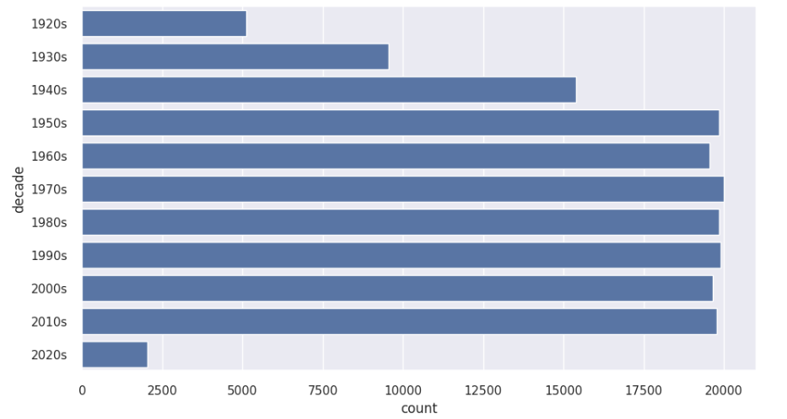
Overall sound of music has changed from 1921 to 2020.
Data group by year

Slide 10
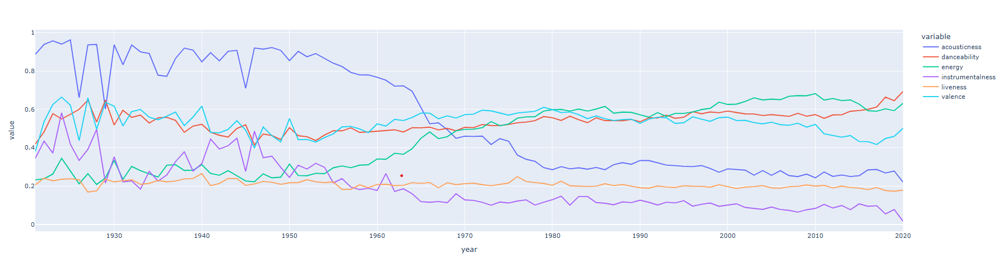
Analyzed key sound features
Analyzed key sound features: acousticness, danceability, energy, instrumentalness, liveness, valence

Slide 11
Content-Based Filtering
Content-based filtering focuses on the characteristics of the songs themselves, such as genre, tempo, and instrumentation. By analyzing these features, systems can recommend similar songs that align with a user's taste, making the listening experience more personalized and enjoyable.
It compares these features with songs the user has previously liked to find similarities.
The system calculates similarity metrics like cosine similarity to recommend the most relevant songs

Slide 12
Model Building
Clustering Using K-Means
• Used K-Means clustering to group songs with similar features.
• Determined the optimal number of clusters using the Elbow Method.
• Assigned cluster labels to improve recommendation accuracy.

Slide 13
Cosine Similarity for Recommendations
• Measured similarity between songs based on their feature vectors.
• Ranked recommendations based on similarity score and popularity.
• Improved personalized music recommendations.

Slide 14
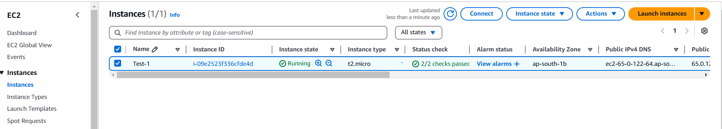
Deployment on EC2

Slide 15

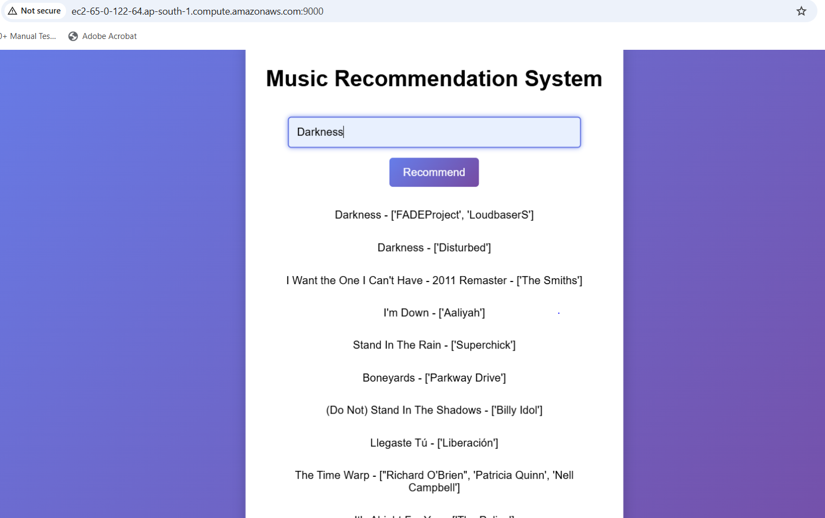
Input
Recommendation System

Slide 16
Conclusion
• Developed a music recommendation system using content-based filtering.
• Used clustering and similarity measures for better recommendations.
• Future improvements can enhance real-time and personalized suggestions.

Slide 17
Thank You

